Slide 1
VIDEO BASICS

Slide 2
Video From Start to till now
Monochrome Video
Black & White
Have luminance (brightness) signal and bandwidth
Color TV Video
3 color
Increase in bandwidth

Slide 3
ANALOG VIDEO
NTSC
Used in North and South America
30 frames per second with aspect ratio of 720x480
Each frame is made up of 525 scan lines
PAL
Use in Asia and other parts
25 frames per second with aspect ratio of 720x576
Each frame is made up of 625 scan lines
Display faster than NTSC
More information

Slide 4
ANALOG VIDEO
SECAM
Developed in France
625 lines
25 frames per second

Slide 5
Interlaced vs Progressive
Interlaced | Progressive
NTSC or PAL or SECAM | Home or office Desktops
Shows odd lines 1st and even lines | Shows in sequential order
Have ghost flickering issue | No ghost flickering issue
Not good for details Less bandwidth compare to Progressive | Suited specifically for details Higher bandwidth

Slide 6
DIGITAL VIDEO
Audio /Visual in binary format
Easy to store and transfer
Use component video
Advantages over analog
Direct random access --> good for linear video editing
Compression
Transfer

Slide 7
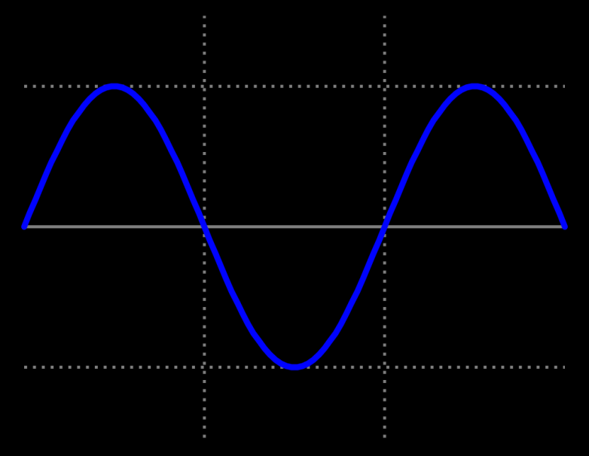
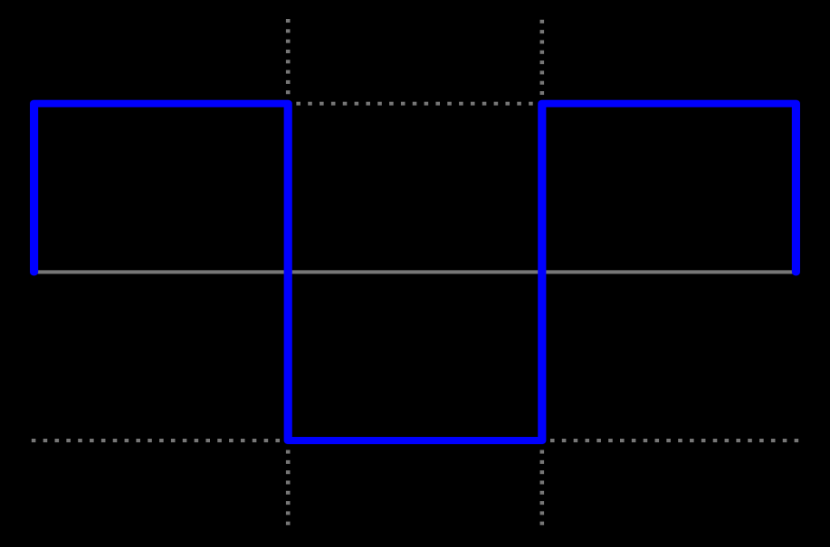
Analog vs Digital
Analog Signal | Digital Signal
Continuous signal | Discrete signal
Sine wave | Square Wave

Slide 8
SD vs HD vs 3G
SD | HD | 3G
525 or 625 | 1080i or 720p | 1080p
270 Mb | 1.5 Gb | 3Gb
480i or 576i | 1920x1080 or 1280x720 | 1920x1080

Slide 9
Video Format
Format = Resolution + Frequency + Frame rate
Resolution = height in pixels X width in pixels
Eg: 1920 x 1080 for 1080i & 1024x720 for 720 p
Frequency of the video signal
Eg: 59.94Hz for NTSC and 50Hz for PAL
Frame rate shows the frames per second
Eg: 59.94i for NTSC and 50p for PAL

Slide 10
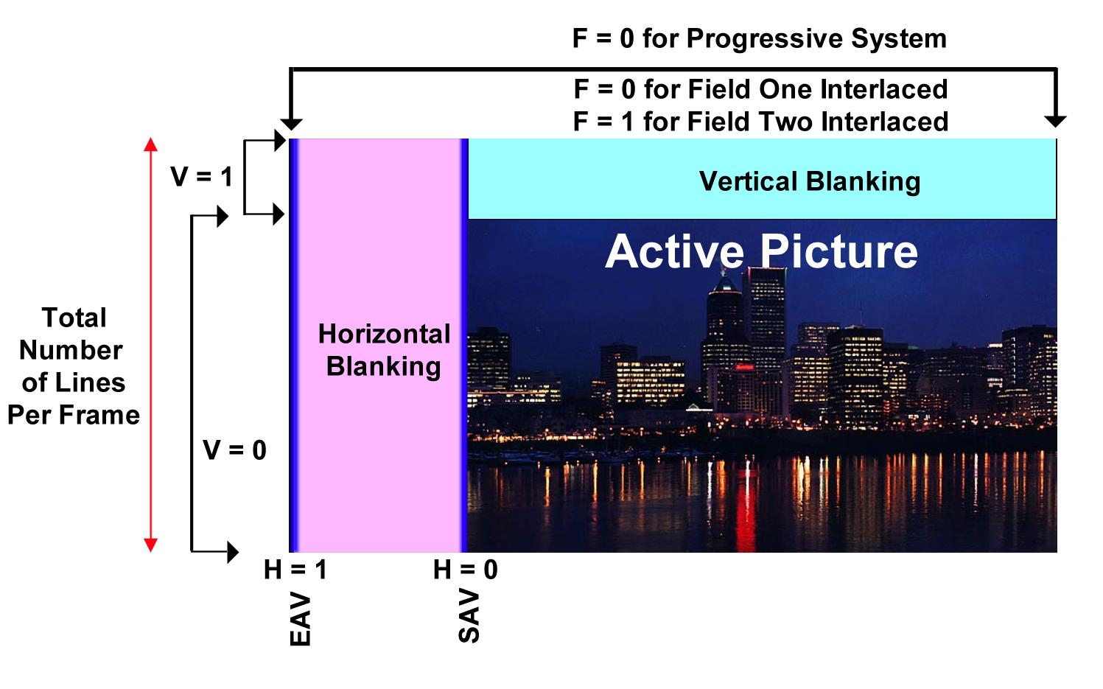
Video Frame
Teletext, close captions, XDS information are send through vertical blanking

Slide 11
Audio
Analog Audio | Digital Audio
Direct recording | Stream of signal data
Mainly have two audio channels | No limit in audio channel
 | Record while video is recorded
Different Kind
Mono | Stereo | Surrounding

Slide 12
Types of Audio
PCM
Product of conversion technique
Analog to Digital
Stereo pair audio
Dolby Digital
Digital audio coding techniques to reduce the data
Can be any kid mono,stereo, 4 channel, 5.1 channel … etc
Used to know before as AC-3

Slide 13
Ancillary Data
AFD ( Active Format Description)
Sets of code send with video to carry information
Both in MPEG video streams and Baseband
Aspect ratio and active picture characteristics are the main information that AFD carry
Used to generate wide screen signaling (WSS)
WSS (wide screen signaling )
Digital stream embedded in analog tv signal describing the quality of broadcast ( eg : Aspect ratio of the image)

Slide 14
Ancillary Data
TeleText
Created by UK
Send in vertical blanking internal
Contain text based information about the video content
Close Captioning
Process of displaying text on a tv or video screen
Transcription of the audio portion
For SD close caption are encoded in to line 21 of vertical blanking interval
Two standards of close caption CEA-608 used for analog television and CEA-708 closed captions used in digital television

Slide 15
Ancillary Data
Close Captioning
CEA -608 or EIA -608 | CEA-708 or EIA-708
For analog television | For digital television
Can transmitted on analog and digital television | Only for digital television
Supports up to 2 languages | Support multilingual captions
Transmitted in line 21 | Embedded in MPEG-2 streams
Caption position fixed | Caption position can be changed

Slide 16
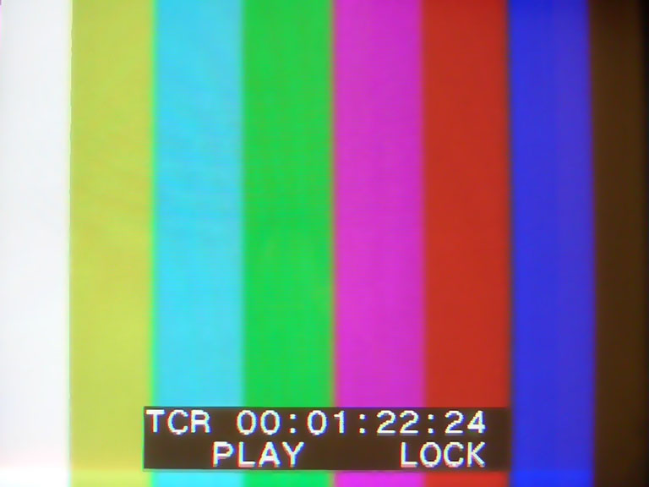
Ancillary Data
VITC ( Vertical Interval Time Code)
Timing signal part of the video
Encoded in to vertical blanking interval between successive picture frame or in vertical interval
VITC assigns time in hour ,minutes and seconds along with frame number
Used to keep playback machine synchronized with master time source

Slide 17
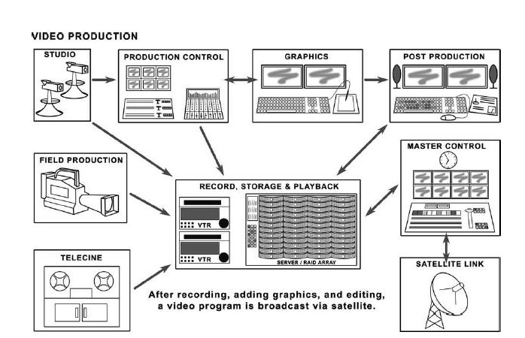
Broadcasting

